Slide 1
Workday Purchase Item Conversion
July 2020

Slide 2
Item Types
The item types are largely distinguished by on whether they reside in a perpetual inventory site
Stock Items
Reside in a perpetual inventory site
Ordered in bulk
On-hand balances and average cost are maintained in Workday
Items are expensed when issued
Replenished by Inventory Replenishment process
Non-Stock
Do not reside in a perpetual inventory site
Ordered direct from supplier
Quantity on hand and average cost are not maintained
Just In Time
Do not reside in a perpetual inventory site
Ordered direct from supplier at the lowest unit of measure using JIT Requisition Type and JIT Pricing
Quantity on hand and average price are not maintained
Consignment
Resides in a perpetual inventory site
Organization pays for the item upon usage

Slide 3
Customer Pain Points
Item terminology of stock, non-stock, catalog
Difference between unit of measures and how they relate to legacy units of measure
Item setup: spend categories, purchase item groups
Extracting data from legacy system
How to clean the item master data prior to loading into Workday
Directly in the legacy system or via spreadsheet extract
Filling in the EIB
Effort to test items in Workday
Auditing the item data load
Reconciling item changes in the legacy system if the data is pulled at point in time
Whether to use Catalog Items
Volume of items to convert

Slide 4
Opportunities
Organize and standardize item details (naming conventions, item groups)
Rearrange item locations in the warehouse
Evaluate item’s purchase history and decide whether to convert the item to the new system
Implement lot/serial tracking for items where manual lot/serial tracking is in use
Maintain consignment items in Workday item master and begin tracking usage

Slide 5
Discovery
Discovery Question | Customer Action
Does the organization want to keep the current numbering or restart item numbering in Workday? | Understand what the differences are when renumbering (tying back to legacy data)
Is there the desire to standardize the item names and descriptions? | Determine the standardized naming convention Update item name and description
Will any item units of measure change? | Identify items that require a UOM change and the what will be the new UOM Determine adjustments needed to inventory balances if a stock item
Are there items in the legacy system that will move from stock to non-stock in Workday? | Adjust out QOH (issue) Move items out of the stocking location
For stock items, do you plan to move item locations in the warehouse? | Determine the new stocking location Determine timing to physically move the item
Is there a concept similar to item groups in the legacy system? Does the organization want to use the same groupings or re-evaluate? | Understand how/where item groups are used in Workday Determine what level of grouping is desired by the organization Identify purchase item groups Map items to purchase item groups
Are there multiple manufacturers? Are the manufacturers in the legacy system correct? | Identify the items that have inaccurate manufacturer Update manufacturer information on the item
What item characteristics does the organization need to track or report on that are not fields in Workday? | Identify item characteristics tracked in legacy system, why they are tracked, determine if they are still needed. What characteristics would the organization like to track that they have not been able to in the legacy system? Identify the item tags and their purpose Map item tags to the items

Slide 6
Discovery
Discovery Question | Customer Action
Are there any items that have lot or serial tracking? | Determine if there are items that are lot or serial tracked today in the legacy system or are tracked outside the system Decide if there are items where lot or serial tracking should be enabled
Are there items priced differently based on where they are shipped-to or company? | Create a mapping of the item, company, ship-to and price
Do you typically have linear pricing? | None needed
Does the organization order supplies Just In Time with LUM price points? | Identify items that are JIT and the pricing for ordering non-JIT and JIT.
Are mark-up costs added to item pricing? Are these separate costs in today’s system or are they one price? | Identify pricing structure for items
Are there any special pricing structures such as tiered pricing? | Research if there are any items with special pricing structures Work with consultants to determine if Workday can accommodate
Does the organization have items on a supplier contract with negotiated pricing? | Gather contract data and item mapping Decide if contracts should be loaded into Workday and attached to items
Are the packaging strings available in the legacy system? | Determine if packaging string can be extracted from legacy Does the packaging string need to be built
Are lead times of interest to the customer and how do they maintain them today? How often are the lead times updated? | Determine lead times or decide if they want to leave them blank and populate after go-live

Slide 7
Discovery
Discovery Question | Customer Action
If there are stock items, is ABC tracked? How often are these updated? How are they updated? | If they exist in the legacy then make sure the ABC is mapped to the items
Who manages items today? | Understand security structure in Workday and that one role manages all of the item details.

Slide 8
Other Considerations
Reference ID’s for the converted items - Setting the reference id equal to the item id makes EIB data mapping simpler
Work with the integration team on which systems require an item sync.
Work with the reporting team to define custom reports. For example, a report that shows items by inventory site.
Dashboards to view item configurations and statistics. Search on Community for posts of example dashboards
Work with the customer and reporting team to identify the KPI’s the customer wants to use and what item related data is needed.

Slide 9
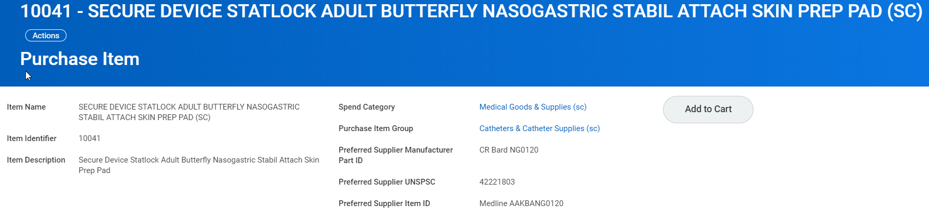
Purchase Item

Slide 10
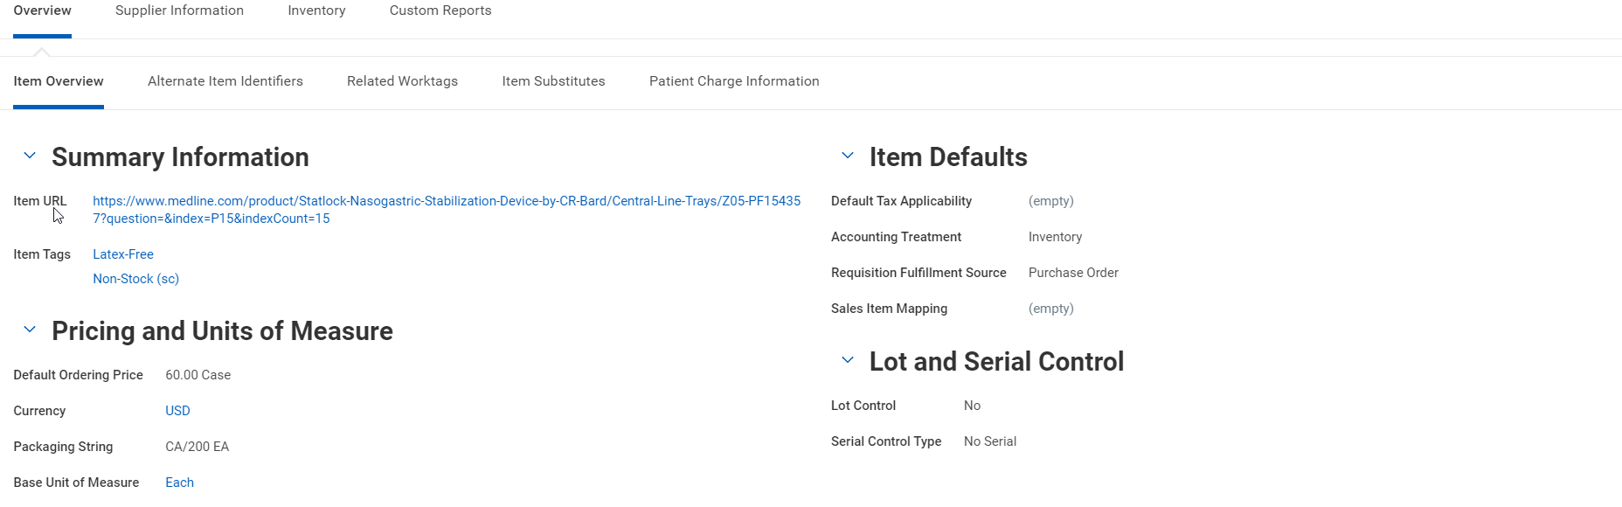
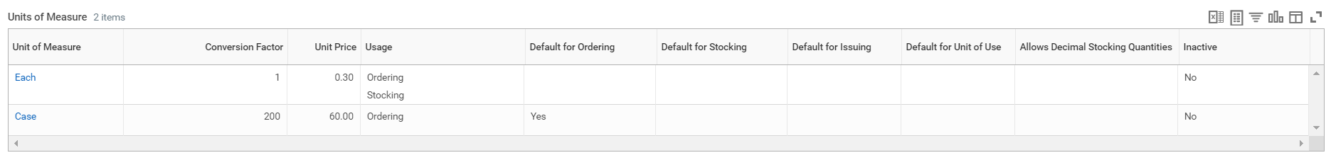
Purchase Item Overview

Slide 11
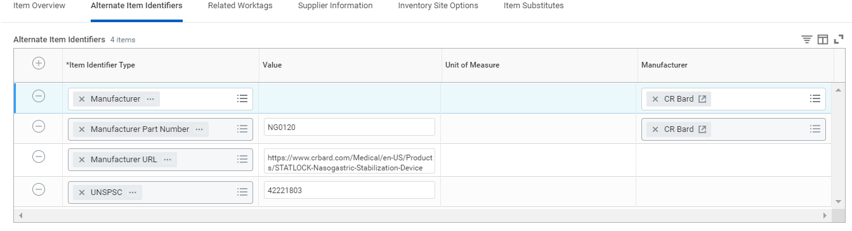
Purchase Item: Alternate Item Identifiers

Slide 12
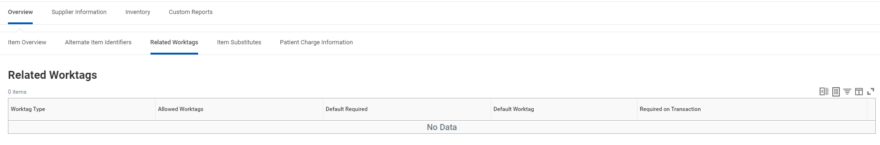
Purchase Item: Related Worktags

Slide 13
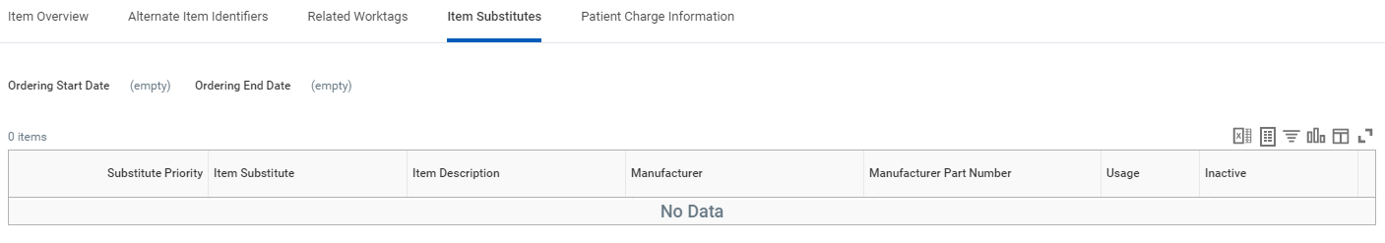
Purchase Item: Item Substitutes

Slide 14
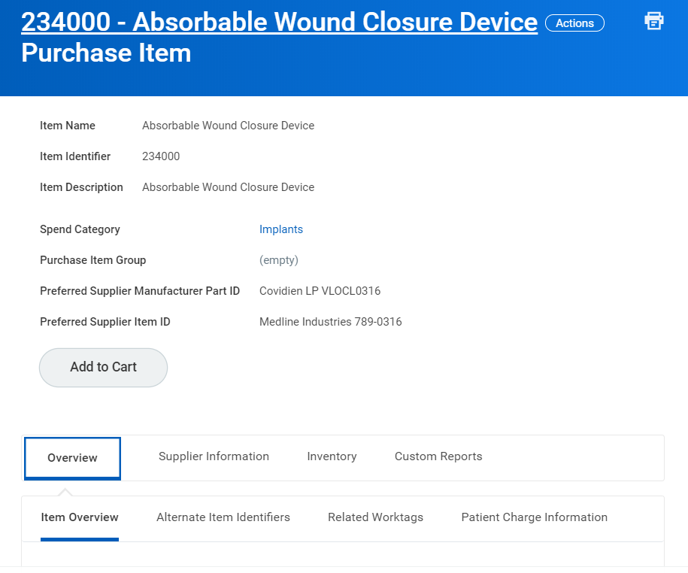
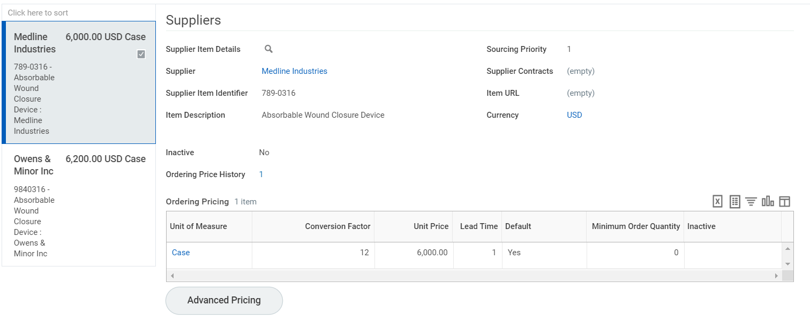
Purchase Item & Supplier Item
Absorbable Wound Closure Device
Spend Cat: Implants
Packaging String: CS/12 EA
UOM: Case 12 EA (Order) / Each (Stock, Issue, Use)
Manufacturer/Part ID: Covidien LP / VLOCL0316
Medline
Supplier Item ID# 789-0316
Order UOM: Case
Price: $6,000
Primary
Owens & Minor
Supplier Item ID# 9840316
Order UOM: Case
Price: $6,200
Purchase Item
Supplier Item

Slide 15
Supplier Items
Description
Ability to define supplier information on the purchase items.
Supplier information: supplier, item identifier, description, currency, lead time, URL, pricing, UOM
Ability to add supplier contracts
Ability to add sourcing priority
Ability to define ordering UOM price by time, company, or ship-to location through advance pricing.
Benefits
Helps to reduce time and effort to maintain the supplier catalog and item master.

Slide 16
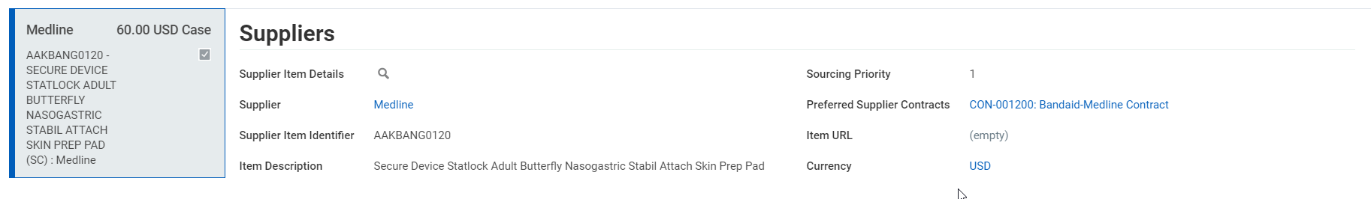
Supplier Item

Slide 17
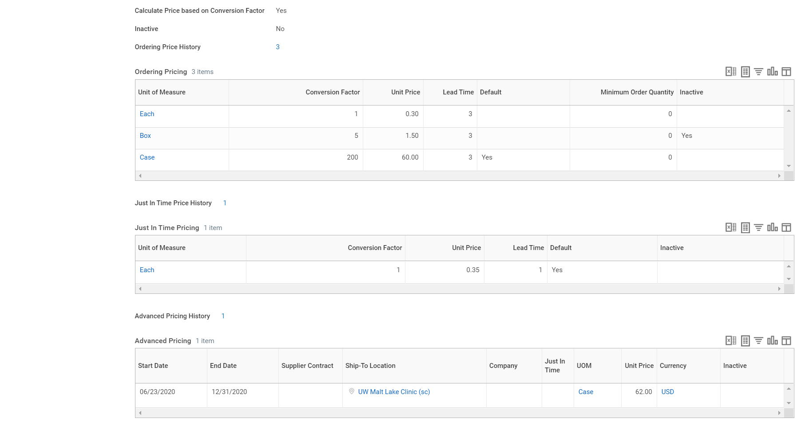
Supplier Item: Pricing

Slide 18
Data loads
Data Loads | Task in Workday | Pre-Requisites
Purchase Item Groups | Maintain Purchase Item Groups | None
Manufacturers | Create Manufacturer | None
Unit of Measure | Maintain Units of Measure | Unit of measure dimensions
Supplier | Create Supplier | Pre-requisites to suppliers are managed by the AP team.
Supplier Contracts | Create Supplier Contract | Supplier, Contract Types. Other pre-reqs depend on options selected on the contract type. Example-if a contract type has manual PO’s then Buyer is required.
Create Locations: Inventory site Stocking location Par location Ship-to Deliver-to | Create Location | The inventory site should be created prior to stocking locations
Location Attributes: Inventory site attributes Stocking location attributes | Maintain Inventory Site Maintain Stocking Location | Inventory site, Stocking location
Purchase Items (Supplier Items) | Create Purchase Item | Required for all items: Spend category Required for stock items: inventory site, stocking location Optional: purchase item group, item tags, alternate item identifiers, supplier contracts
Par Items and Bins | Maintain Par Locations | Par location, purchase Items, stock request type, requisition types, inventory site
Customer account numbers | Maintain Location Customer Account Numbers | Supplier, ship-to locations

Slide 19
2020R2
Item related enhancements for 2020R2 (Safe Harbor Applies)
Item Mass Maintenance Tool
New purchase item request
Change and item base UOM
Setup and track spend by commodity code

